Slide 1


TASK 6
INTERNET PROGRAMMING AND MOBILE PROGRAMMING
DATABASE DESIGN AND IMPLEMENTATION

Slide 2
Outline
Introduction
Database Design Overview
Database Design Process
Database Implementation
Importance of Database Design
Conclusion

Slide 3
Introduction
Database design is the process of creating a detailed data model of a database. This process involves defining the structure, storage, and retrieval mechanisms of data to ensure the database meets the requirements for data integrity, security, and performance.

Slide 4
Database Design Ovieview
The biometric attendance mobile app utilizes biometric authentication technologies to accurately record student attendance.
Key features of the application include user registration, biometric data capture, attendance recording, and comprehensive reporting and analytics.

Slide 5

Designing a database involves
Requirement Analysis
Conceptual design
Logical Design
ER diagram Design

Slide 6
Database Design Process
Requirement Analysis
Functional Requirement
User Registration and Management
Biometric Data Storage
Attendance Recording and Management
Reporting and Analytics

Slide 7
Database Design Process
Non-Functional Requirement
Real-time
Availability
Security
Scalability
Performance

Slide 8
Database Design Process
Conceptual Design
Logical Design
ER diagram development

Slide 9
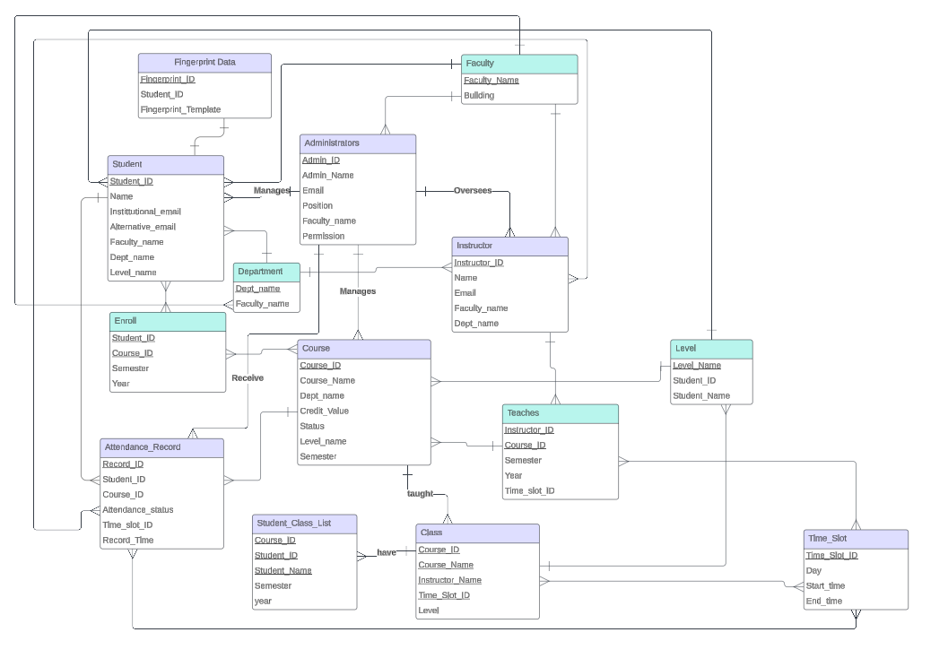
Database Design Process

Slide 10

Database Implementation

Slide 11
Database Implementation
Reasons for choosing Firebase DBMS
Real-time Synchronization
Automatic Caching
Seamless Offline Experience

Slide 12
Database Implementation
Reasons for choosing Firebase DBMS
Scalability
Security

Slide 13
Importance Of Good Database Design
Data Integrity
Scalability
Efficiency
Security
Maintainability

Slide 14
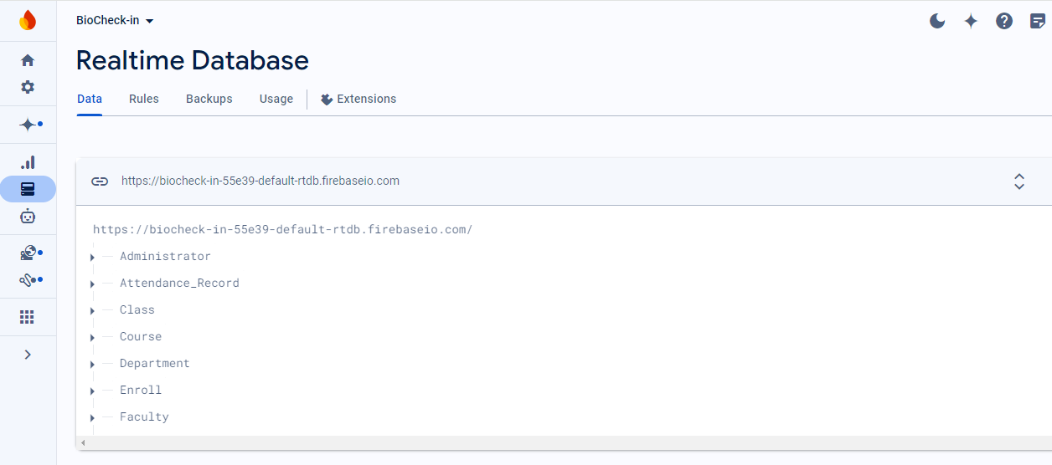
All the Entities with their attribute generated in Firebase Real-time Database

Slide 15
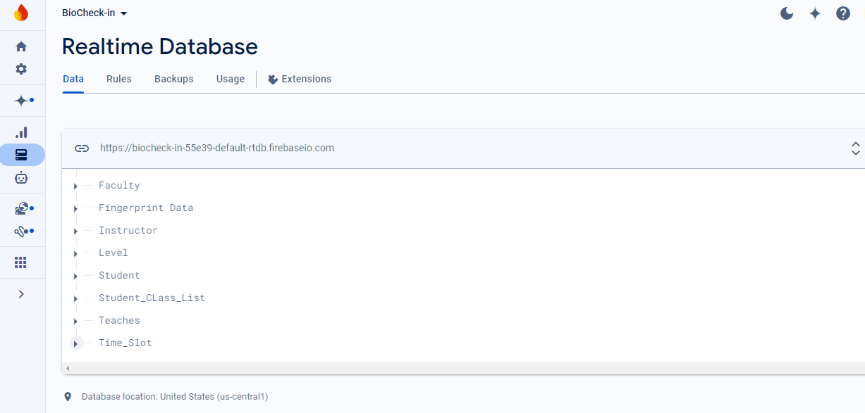
All the Entities with their attribute generated in Firebase Real-time Database

Slide 16
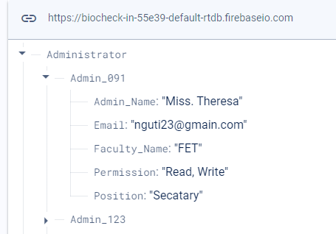
All the Entities with their attribute generated in Firebase Real-time Database

Slide 17
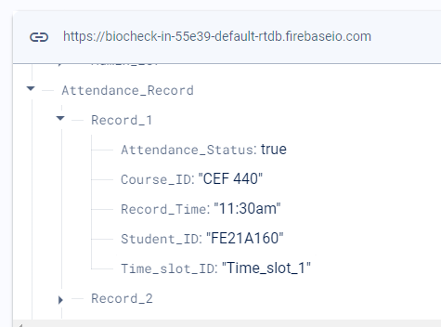
All the Entities with their attribute generated in Firebase Real-time Database

Slide 18
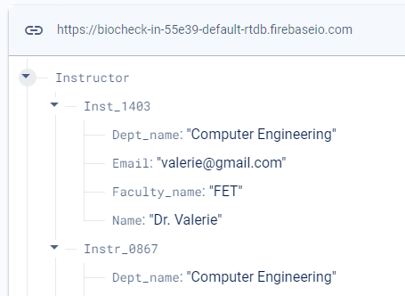
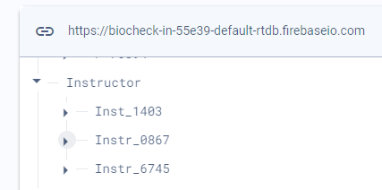
All the Entities with their attribute generated in Firebase Real-time Database

Slide 19
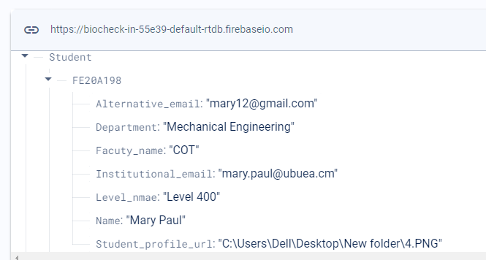

All the Entities with their attribute generated in Firebase Real-time Database

Slide 20

All the Entities with their attribute generated in Firebase Real-time Database

Slide 21
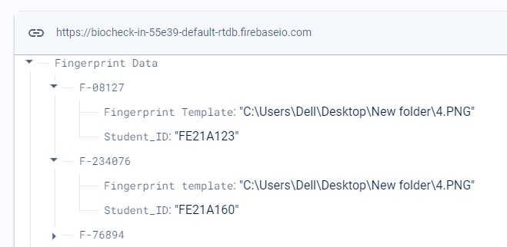
All the Entities with their attribute generated in Firebase Real-time Database

Slide 22
Conclusion
It is of importance to look at certain non-functional requirements such as availability, performance, security and scalability, when designing a database in order to achieve the best functioning and secure application.

Slide 23

Thank you

